Slide 1
CFCs and the Ozone Layer

Slide 2
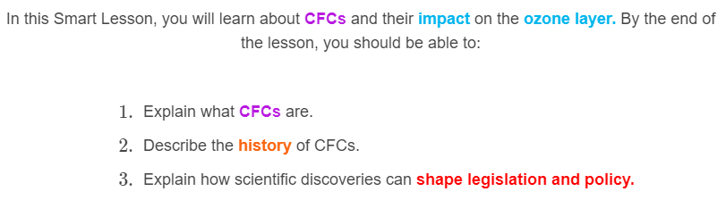
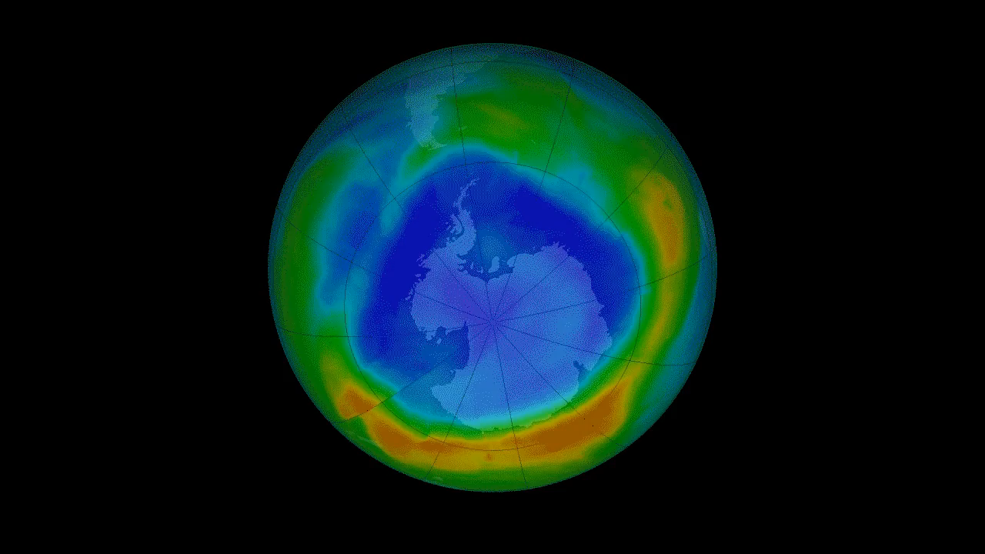

Slide 3
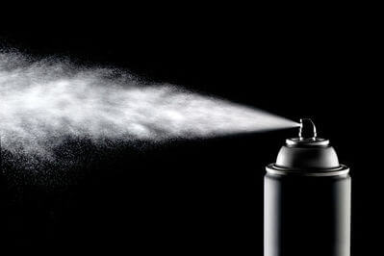
Chlorofluorocarbons, or CFCs, are organic compounds made of carbon, chlorine, and fluorine.

Slide 4

CFCs are derived from ethane, methane, and propane.
They have low toxicity, low reactivity, low flammability and are easily vaporised.
Due to these properties, they were used as fire-fighting materials, propellants in aerosol cans, as solvents and as refrigerants in fridges.

Slide 5
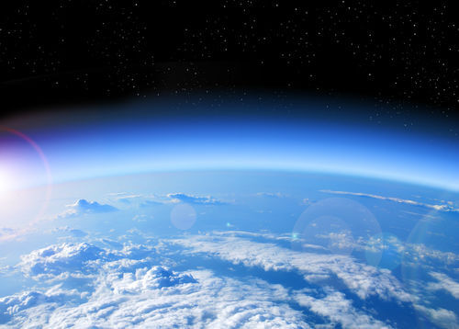
The ozone layer is a layer of ozone (O3​) in the stratosphere, about 20 km to 30 km above the Earth's surface.
Ozone is comparatively sparse, with levels of only 10 parts per million (10 "parts" of ozone per million "parts" of atmosphere). This is about the same as one drop of food colouring in 50 L of water. By comparison, the concentration of oxygen in the atmosphere is about 200,000 parts per million.
Despite this low concentration, ozone absorbs around 98% of the Sun's ultraviolet radiation.

Slide 6

Ironically, the one of the properties that made CFCs successful as a solvent, refrigerant, and fire-fighting material is the same property that make it destructive to the ozone layer!
The fact that CFCs have low reactivity means they have a lifespan that can exceed 100 years, giving them time to spread through the atmosphere.

Slide 7
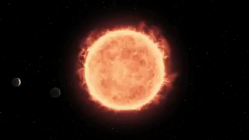
The long lifespan of CFCs allows them to migrate into the upper stratosphere.
Here, the ultraviolent light from the Sun is strong enough to break the C−Cl bond in the CFC molecule.

Slide 8
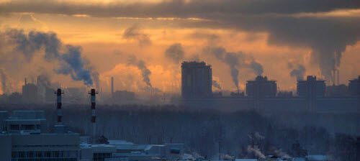
The broken bonds of CFCs result in chlorine free radicals.
Ozone (O₃​) is able to be destroyed by various free radical catalysts; most notably hydroxyl, nitric oxide, chlorine and bromine free radicals. Each of these is extremely reactive.

Slide 9

While these free radicals have natural sources, most of the chlorine and bromine free radicals are from manmade sources.
Ozone depletion has been observed to increase as emissions of CFCs increased.

Slide 10

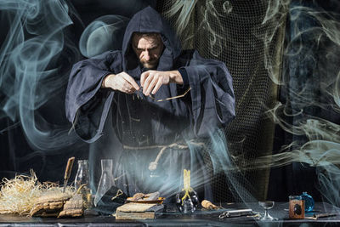
Chlorine and bromine free radicals destroy ozone (O₃​) through a relatively simple reaction:
The chlorine atom reacts with the ozone molecule, taking an oxygen atom to form ClO. A regular O2​ is left over with the chlorine monoxide.

Slide 11

However, it doesn't end there!
The chlorine monoxide molecule can react with another molecule of ozone:
This reaction results in another chlorine free radical which will go on to react with other ozone molecules. This creates a cycle where ozone is continually destroyed by chlorine or chlorine monoxide.
Bromine is even more effective at destroying ozone, though there is much less of this in the atmosphere.

Slide 12

The ozone layer layer prevents most of the UVB wavelengths of ultraviolent light from reaching the Earth's surface.
Increased exposure to ultraviolent light is linked to increases in sunburn, skin cancer and cataracts, as well as damage to plants and reduction of plankton populations.

